Slide 1
Ch4 - Multiphase Interactions
Air-Water Exchange & Sediment Transport

Slide 2
Sediment Transport
Sediments at the bottom of streams, rivers and lakes can often be made up of toxic solids or have been contaminated over time due to legacy contamination. After surface waters are remediated the sediments can remain as sources for contaminants for much longer times.
The science of sediment transport is complicated as it involves complex fluid mechanics coupled to solid mechanics with interaction at very small scales for particles that can range broadly in size, but the desire being to make predictions over large scales
We will touch on very basic ideas and then rely on an empirical model. My goal here is to introduce you to the broad ideas and if you want to learn more I am happy to provide references and the likes.

Slide 3
Mechanisms – How do Sediments Move
Bed Load
Sliding
Rolling
Saltation
Suspended Load
Advection Dispersion
Buoyancy?
Disolved Load

Slide 4
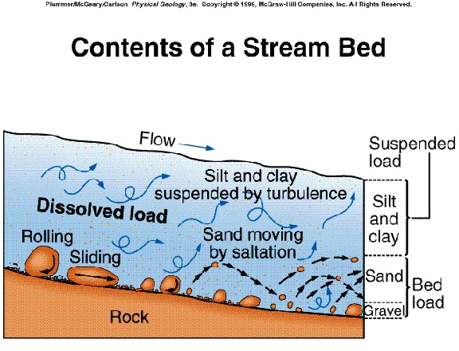
Mechanisms – How do Sediments Move

Slide 5
Particle Settling
How quickly will a small particle of radius r and density ρ_{s} fall in a fluid of density ρ_{f} and viscosity μ_{w}?
Buoyancy
Drag
As long as the particle
is sufficiently small we can
Use what is called Stokes drag
(i.e. low Reynolds number where
Viscous forces dominate)
Weight

Slide 6
Particle Settling
Buoyancy
Drag
Weight

Slide 7
Particle Settling Velocity
Buoyancy
Drag
Proportional
to radius
squared
Weight

Slide 8
Vertical Distribution of Particles in a Water Body
Vertical dispersion tries to mix particles vertically in a water column
Gravity is trying to pull them down
At equilibrium these balance

Slide 9
Question
Resuspended clay, to which toxic metals have bound, is of concern in a local river of depth 2.5m. The clay particles have diameters ranging from 0.5-8 microns and each carry 12% of toxic metals on a per mass basis. You measure a concentration of 1g/m³ of clay particles at the bottom of the river. What is the average concentration of sediment in the river? And how does this correspond to the average concentration of toxic metal. Vertical dispersion in the stream is about 0.1 m²/s. Imagine the river has a cross section that is 5 meters wide.
Is this measure of average concentration useful to predict the total amount of contaminant that is moving downstream (say total mass)? If not, why not? And how might you fix this?

Slide 10
Averaging of Cross terms
In the last problem I was basically asking if you know the average flow rate of a river and the average concentration of sediment, do you know the total amount of mass moving downstream, i.e.
Is ?
Where is the depth average
What do you guys think?

Slide 11
First consider this Seemingly unrelated Problem
Say you measure two variables X and Y you are interested in, because their product Z=XY is something that is important to you (e.g. X is concentration and Y is flow rate – as here)
Series for your variables are
X=[1 4 10] => <X>= 5
Y=[2 4 18] => <Y> = 8
Z=[2 16 180] => <Z> = 66
<X><Y>=40 while <XY>=66 ????
<XY>=<X><Y> + <X’Y’>
This term is so often
forgotten in models
Average of deviations
Don’t worry too much
If you are not sure what
This is – but be aware
Of big idea

Slide 12
Formally
Let’s go back
Even assuming A constant
with depth hard
Mathematica

Slide 13
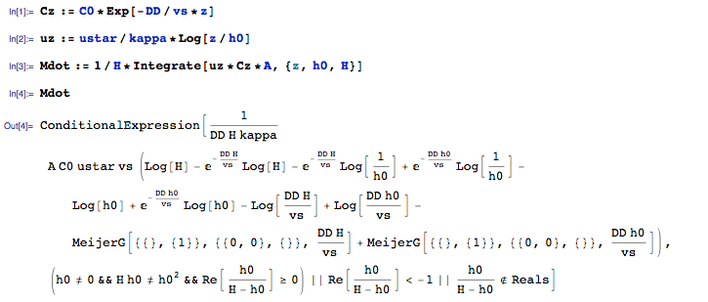
NOT EVEN I LIKE THIS EXPRESSION

Slide 14
But It’s OK IF I HAD SOME SPECIFIC VALUES
Recall
Resuspended clay, to which toxic metals have bound, is of concern in a local river of depth 2.5m. The clay particles have diameters ranging from 0.5-8 microns and each carry 12% of toxic metals on a per mass basis. You measure a concentration of 1g/m³ of clay particles at the bottom of the river. What is the average concentration of sediment in the river? And how does this correspond to the average concentration of toxic metal. Vertical dispersion in the stream is about 0.1 m²/s. Imagine the river has a cross section that is 5 meters wide.
There is still missing information… u* and roughness height h0.
Given we have nothing else let’s assume some typical values (normally we would try to calculate them).
u*=0.2 m/s (assuming energy gradient of 1/1000)
h0=0.05 m
Let’s also only focus on particle size – say 2 microns => v_{s}= 1.3 x 10⁻⁵ m/s

Slide 15
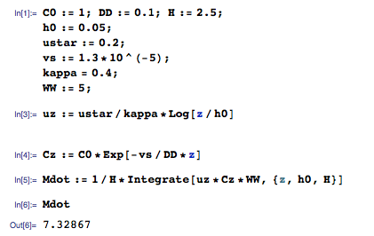
For these
Result
M=7.3 g/s

Slide 16
So
Our models have lots of assumptions
Particles are not spheres
There is not one size of particle, but a large and broad distribution of particles in real streams and rivers
Is dispersion the same for all particles?
Is Stokes assumption reasonable?
What is the concentration C₀ at the bottom of the stream?
Average fluxes require knowledge of velocity and concentration profile – which are both highly uncertain….
What to do – well as scientists we keep trying to do this better, but as engineers we are also happy to sometimes turn to empiricism.

Slide 17
Here’s some Actual Data
Here we have data from the Rio Puerco in New Mexico. What would you do with it?

Slide 18
LIN-LOG, LOG-LIN and LOG-LOG

Slide 19
LOG-LOG
What does
this mean?

Slide 20
Power Law Fit
Y=aX^{b}

Slide 21
Example Problem
You are Given the Following Data Set for a River that undergoes a Baseflow Recession such that its volume flow rate in m³ is given by
where t is time in months. How much sediment is exported is the total baseflow recession lasts 6 months.
Data is online
Open Matlab
Empirical_Example.m
Tonnes per day

Slide 22
Example Problem Continued
Tonnes per day
Tonnes per month
Tonnes

Slide 23
Air-water Exchange
Imagine you have a closer container filled with water and air.
Initially the concentrations are different.
What happens?
Diffusion – but to what point?
C_{air}
C_{water}

Slide 24
Air-water Exchange
The equilibrium between a liquid and gas is not the same as just within a fluid – meaning it is not just trying to homogenize the concentration in the entire box. Rather you get another equilibrium
When this does not hold the system is out of equilibrium and it tries to to drive it to this equilibrium via a flux
C_{air}
α Ostwald solubility coefficient
C_{water}

Slide 25
Air-water Exchange
C_{air}
C_{water}
Gas exchange coefficient
What is it?
What does it depend on?

Slide 26
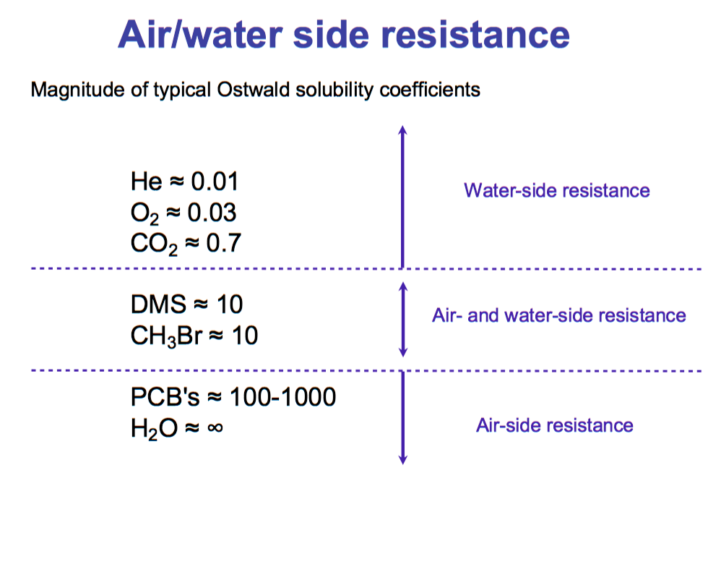

Slide 27
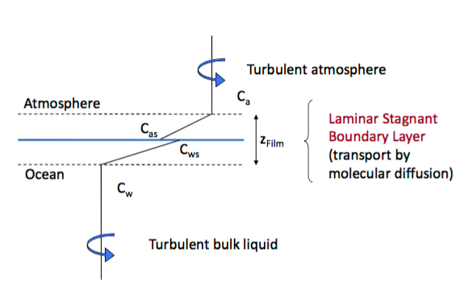
Conceptual Model

Slide 28
So
Thus if I know the exchange coefficient for one substance I can know it for
others

Slide 29
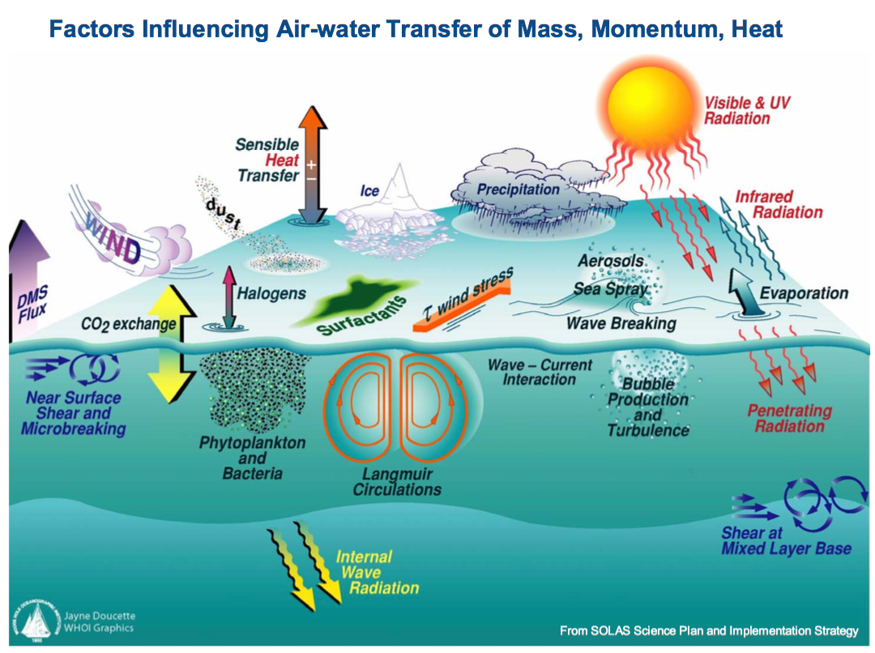

Slide 30
SO - Is stagnant Film Approximation reasonable?

Slide 31
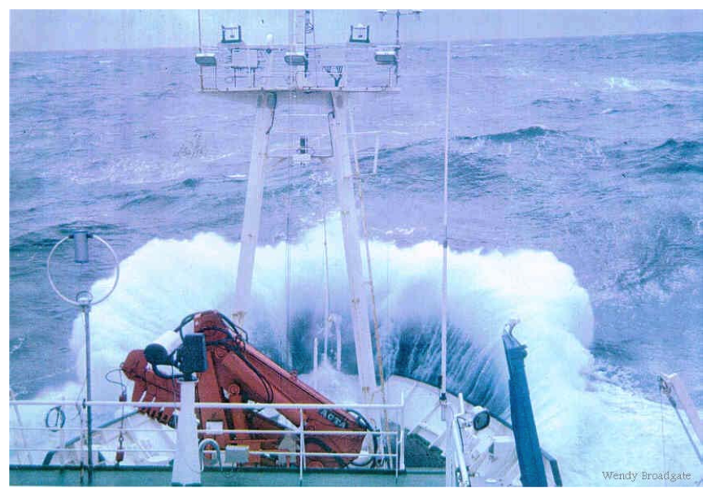
Is stagnant Film Approximation reasonable?

Slide 32
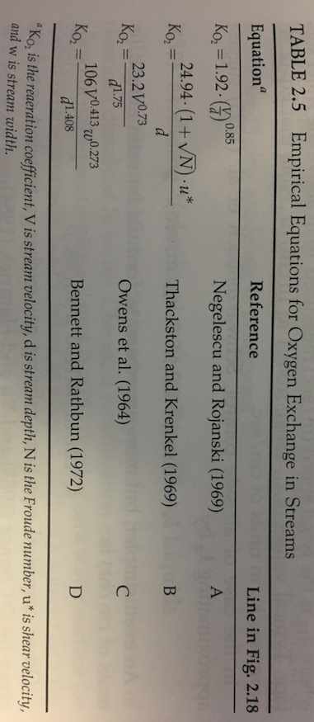
So a lot of times
The exchange coefficient is a function of a lot of different things
And empirical relationships depending on what you’re looking at are abundant

Slide 33
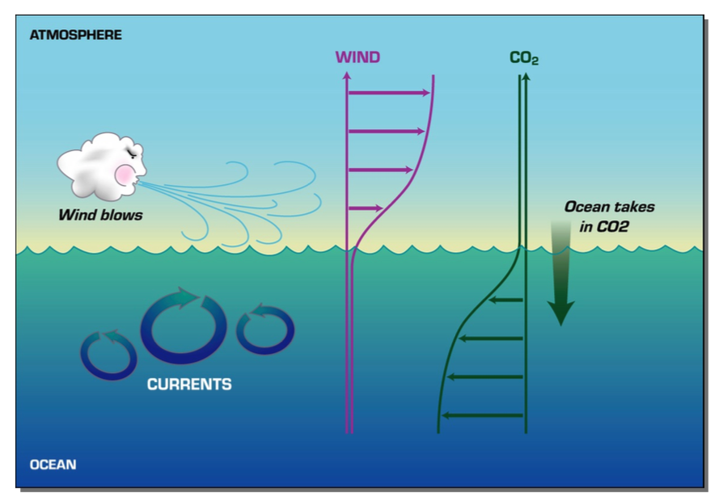
Can anyone help me understand this Figure?

Slide 34
Example
The is concern that the construction of a local power plant will increase local atmospheric CO₂ concentrations by a factor of 2.
There is a local lake whose surface area is 500m² and whose total volume is 5000m³ that local fisherman love, but it is known that if CO levels in the lake rise by more than 50% some of the native fish will no longer thrive there.
Should they be worried about he new equilibrium? Using a diffusion think film model you estimate that the gas exchange coefficient is 10⁻⁸ m/s? How long will it take to reach this new equilibrium? One of the more savy locals knows that its is very windy and that the turbulent exchange coefficient will be 10⁵ times higher? How much less time does that give them to find an alternative solution should it be needed?

